Slide 1
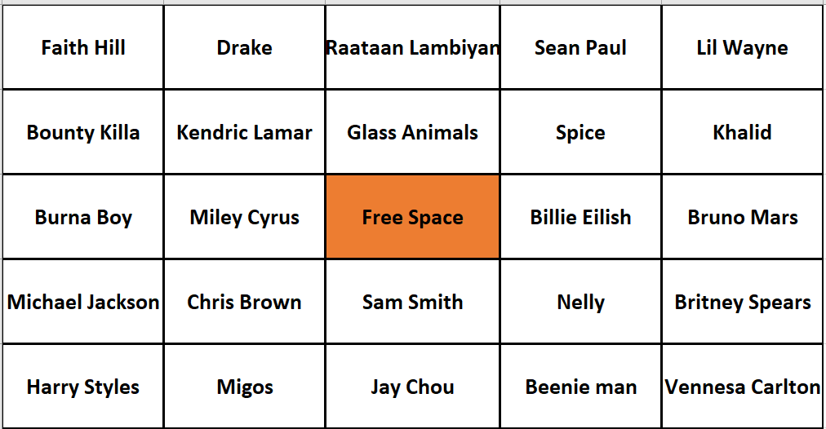
MUSIC BINGO CARD 1

Slide 2
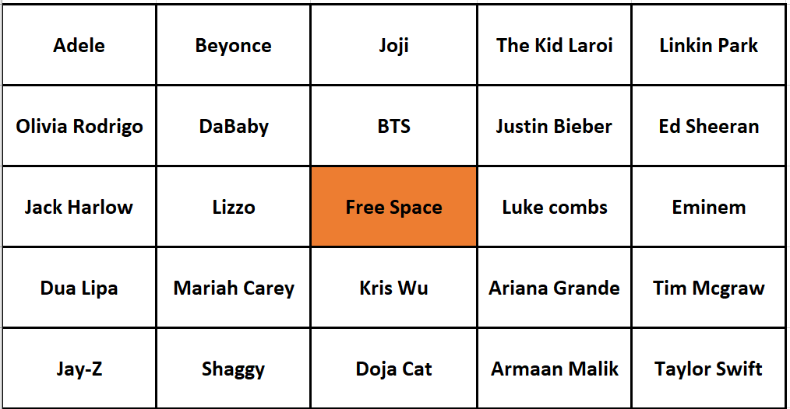
MUSIC BINGO CARD 2

